Slide 1

Virtual Library
22DCE071 Ishani patel
22dce084 tanvi patel
22dce098 vanshita raisinghani

Slide 2

Contents
Overview
Frontend Used
Software used
Features
Previous Work
Module 4 : Books
Module 5 : Dashboard
References
Conclusion
Future work

Slide 3

Overview:
To build a library management which contains Student login
There will be various features like
Issuing and returning books
Paying fine(if any) online
Free PDF’s of books

Slide 4



Frontend used
HTML
CSS
Java-Script

Slide 5

Software used
VS Code

Slide 6
Features of our website
User friendly
Access to many books
Good community

Slide 7
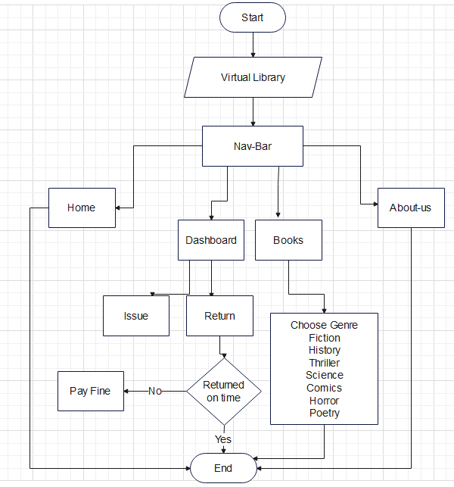
Flow of website:

Slide 8

MODULE 1: home page
Home page is the main page which consists of navbar.
Navbar consists of following items.
1. Login/Sign-up
2. Books
3. About-us
4. Dashboard
It also consists of some of the features.

Slide 9
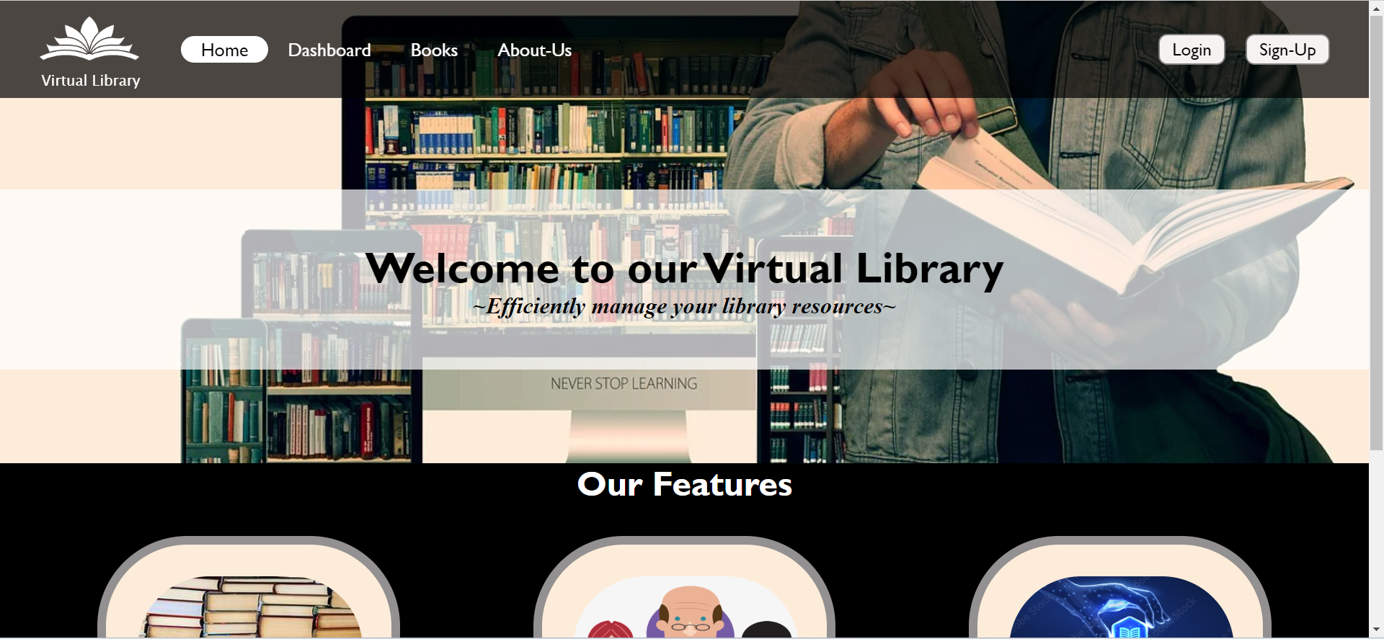

Slide 10

Module 2: Student login
Authentication of the user will be there.
Username and password will be entered. Once both username and password matches, then only a user is allowed to enter into the system (We have not included database).

Slide 11


Slide 12

Module 3: about-us
In this section we have included the basic information about us such as:
1. About our library
2. Information about our team
3. Contact-us

Slide 13
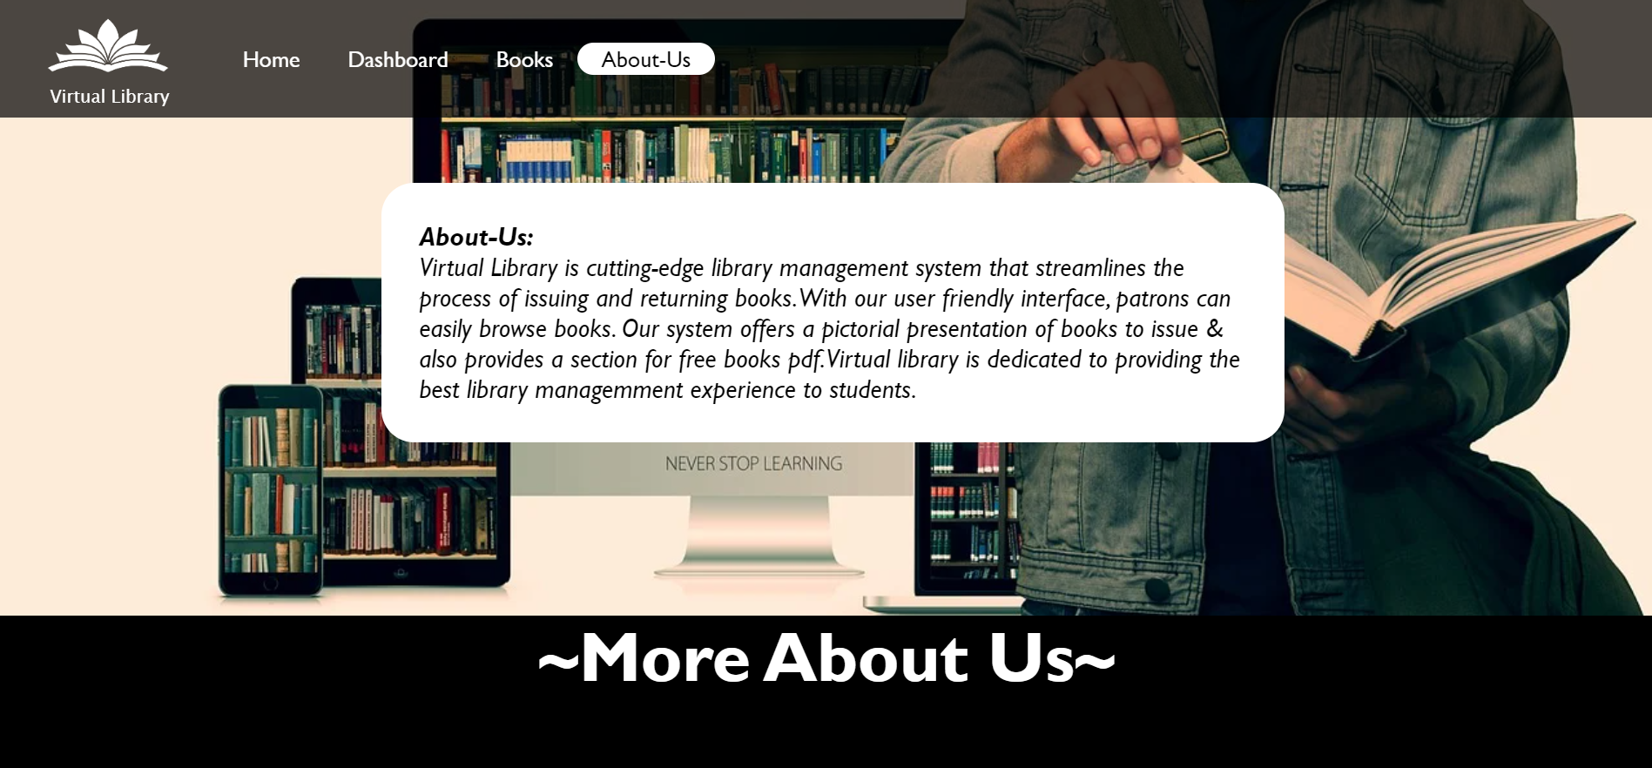

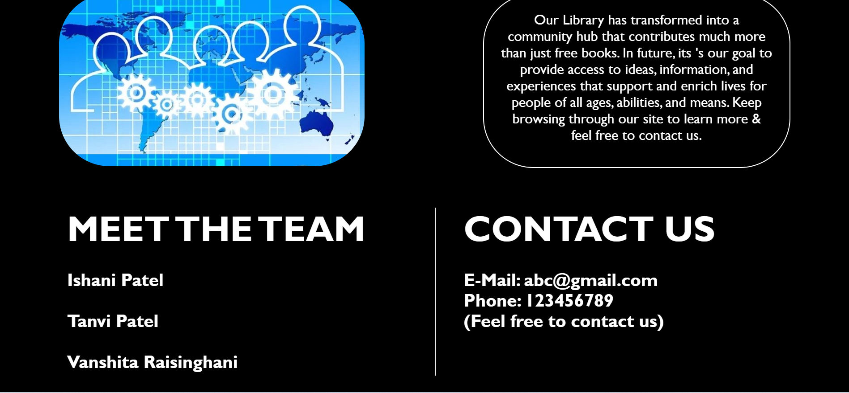

Slide 14
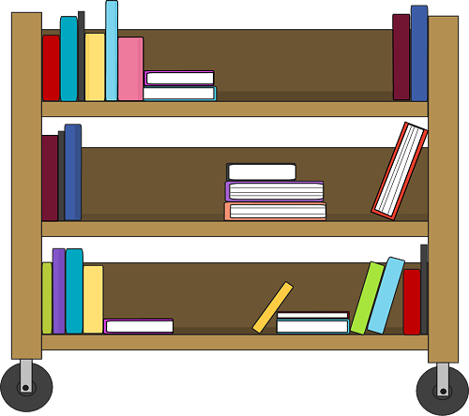
Module 4: books
In this module we have given various options to the user for choosing different genre for our books.
User will have an option of issuing a particular book.
After-wards we will also provide the feature of free PDF for limited books.

Slide 15
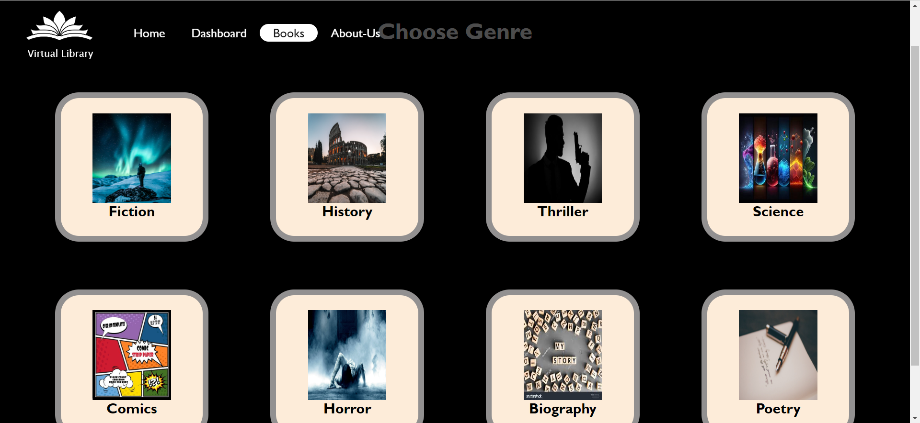

Slide 16
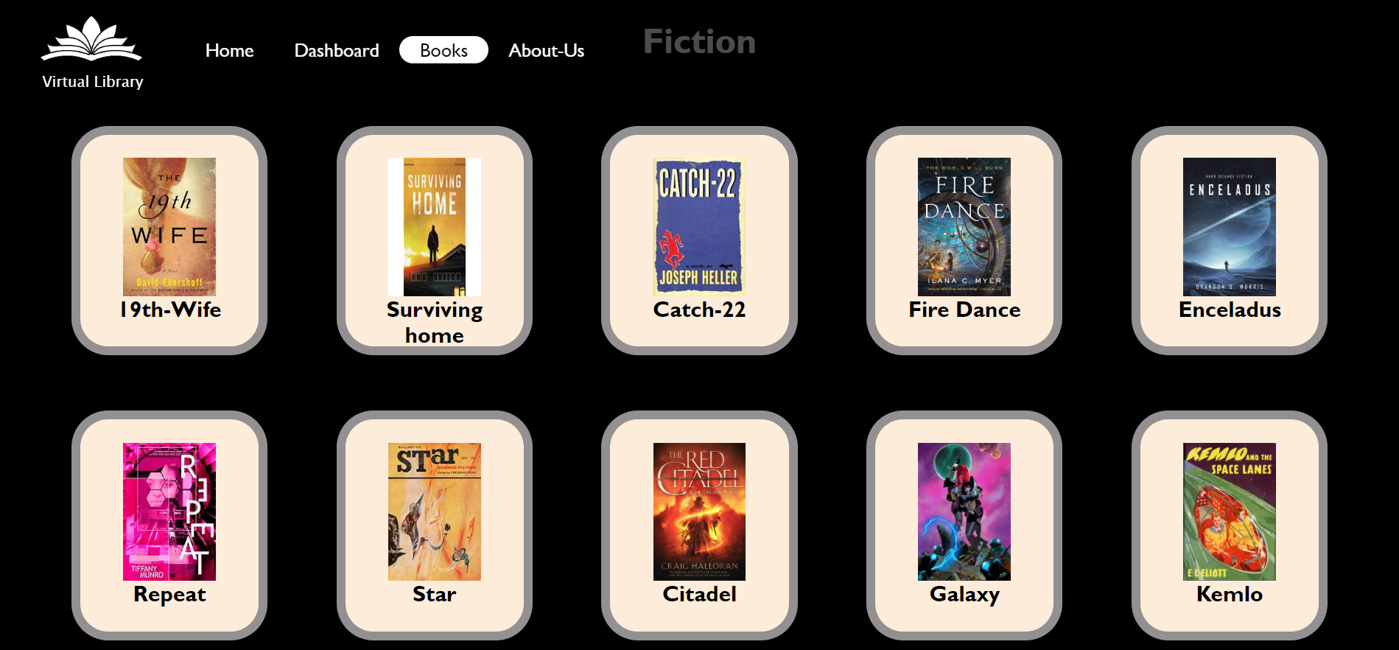

Slide 17
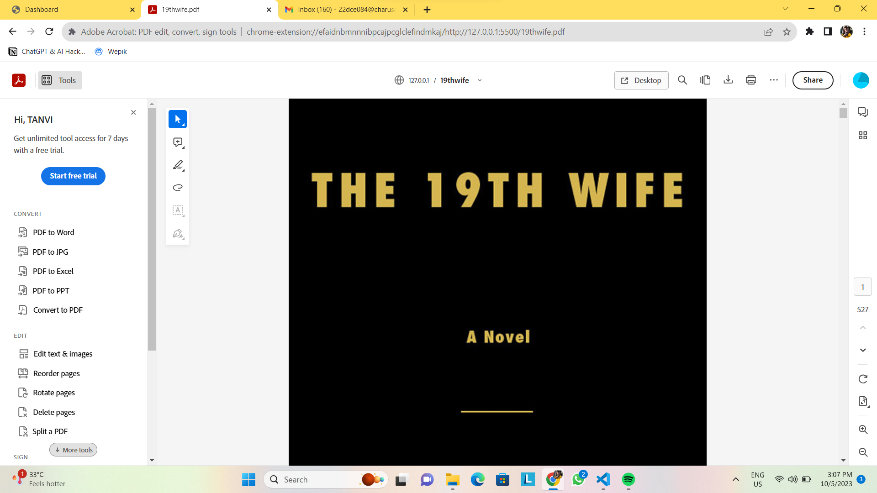

Slide 18

Module 5: dashboard
This is one of the core part of our website.
This feature provides user an option to issue/return books
Also if the user returns the book late, the he/she also have to pay fine

Slide 19
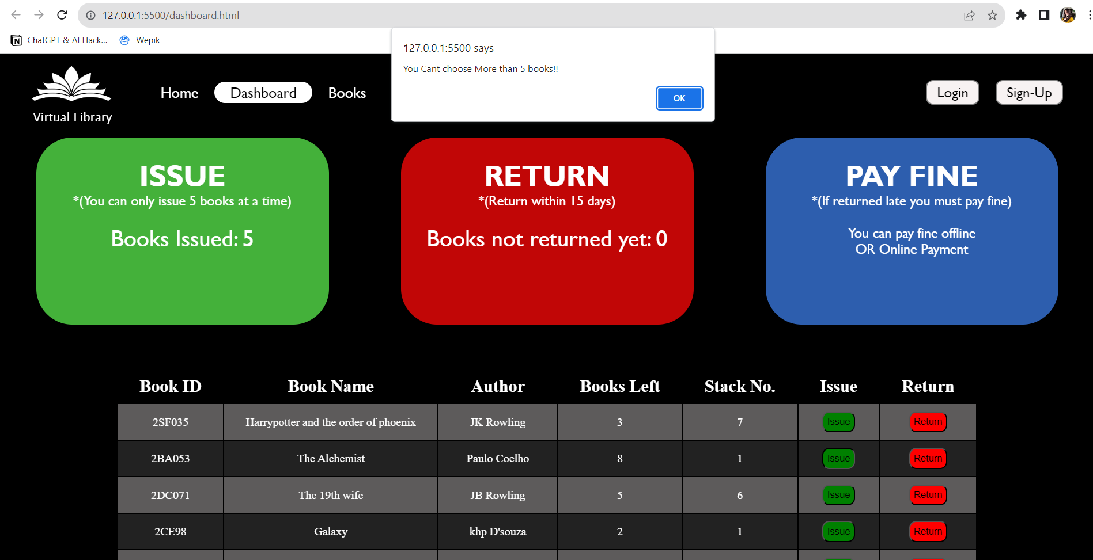

Slide 20
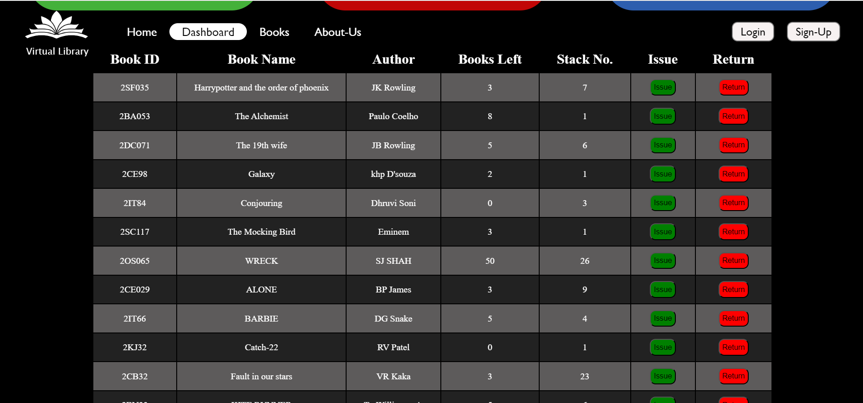

Slide 21

Future work
There are few features that can be added to our website in future. Such as:
1. Adding Social book clubs.
2. Making this website admin based also.
3. Improving accessibility options for people with disability.
But for now we have limited time so we are not approaching these features for now.

Slide 22

conclusion
So our Virtual Library provides user a well defined user experience which allows them to issue/return books online. And also we have added the feature of free PDF for some books.

Slide 23

References:
https://www.w3schools.com/
https://www.apnacollege.in/
https://www.codewithharry.com/

Slide 24
Thank you!

